Slide 1

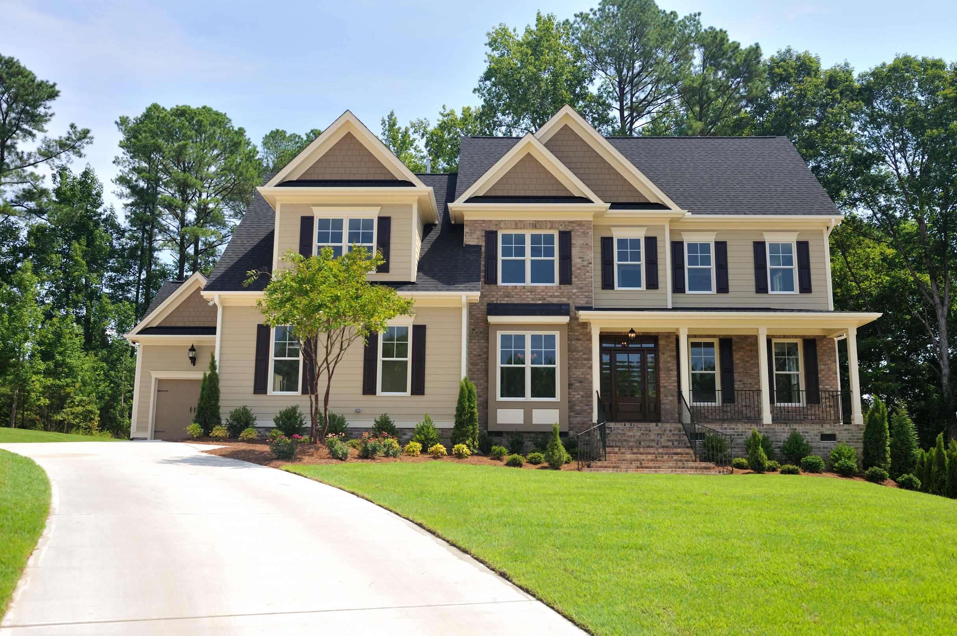
HOUSE PRICE PREDICTION
SUBMITED BY:
VIVEK KUMAR (24CSA3BCO82)
SHASHI KUMAR(24CSA3BC065)
UMESH MISHRA(24CSA3BC094)
RAM SHANKER SHARMA())
KOMAL TANWAR(24CSA3BC126}
GUIDED BY:
MR.ROHIL SIR

Slide 2
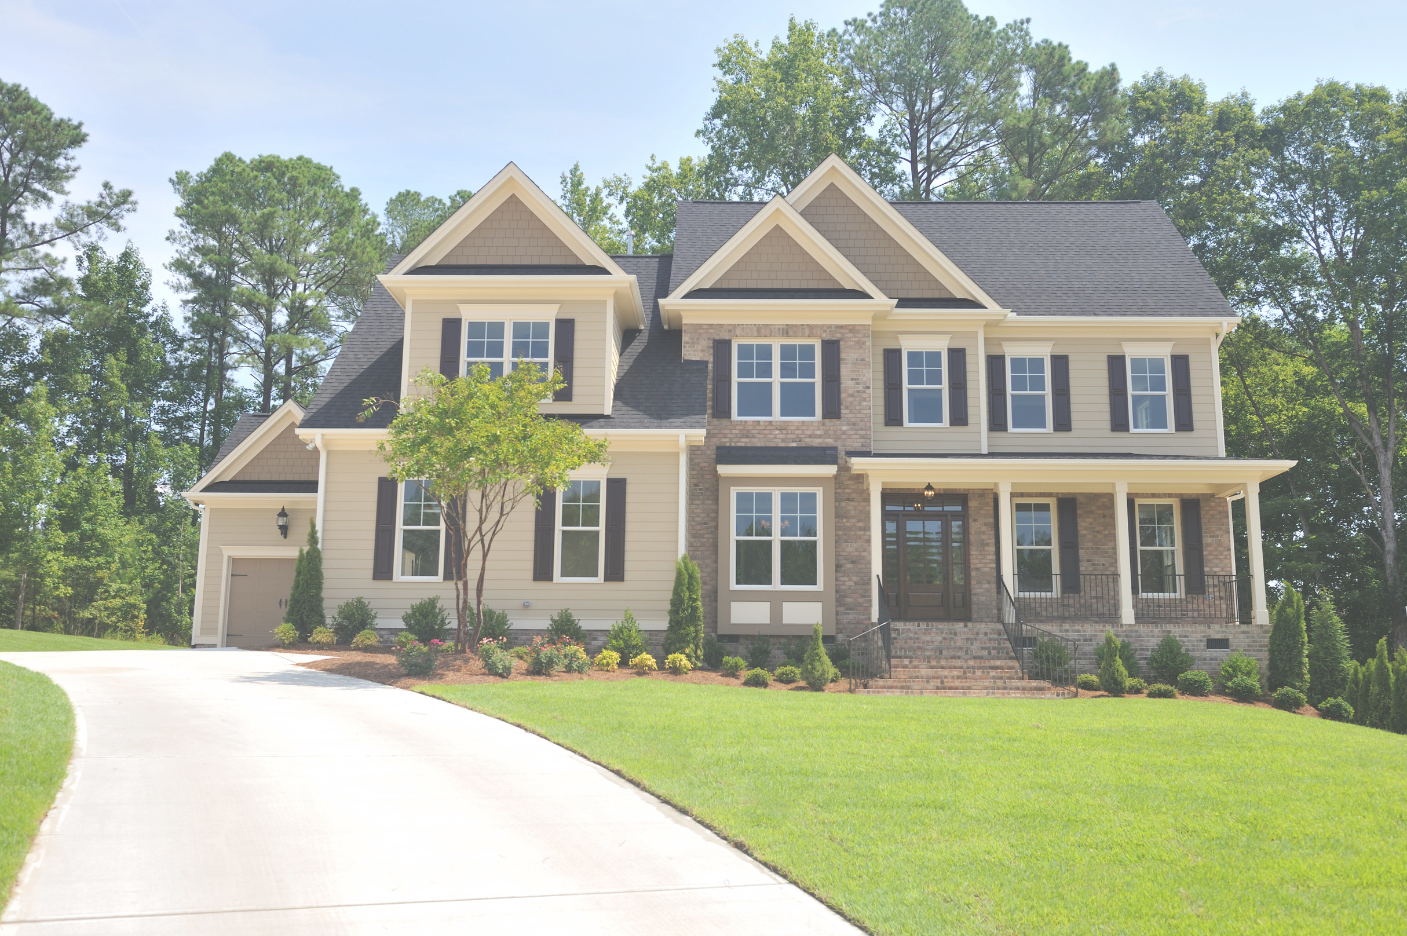
OUTLINE
• Introduction
• Problem Statement
• Project Specification
• Dataset
• Pipeline
• Data Cleaning
• Feature Engineering
• Outlier Detection
• Outlier Removal
• One Hot Encoding
• Model Creation
• K-fold cross validation
• Grid search cross validation
Result/Output

Slide 3


INTRODUCTION
in this project we wil build machine learning model to predict house prices of an indian city
{ Bengaluru } – >
This project will very helpful for the real estate market .
Our model can be used by both house sellers and house buyers .
Multiple linear Regression algorithm is used to create a model with accuracy score

Slide 4
PROBLE STATEMENT
Price of Real estate properties are sorphisticatedly link with our
economy
Despite this, we do not have accurate measures of house prices based on the vast amount of data available.
Proper and justified prices of properties can bring in a lot of transparency and trust back to the real estate industry, which is very important for most consumers especially in India.

Slide 5
PROJECT SPECIFICATION
THE GOAL OF THIS PROJECT IS TO PREDICT HOUSE PRICES IN BENGALURU CITY BASED ON SOME FEATURES SUCH AS LOCATION, SIZE/AREA, NUMBER OF BEDROOMS, AND NUMBER OF BATHROOMS.
BENGALURU HOUSE PRICE DATASET IS USED TO CREATE THE MODEL.
WE ARE USING MACHINE LEARNING ALGORITHM TO CREATE A PREDICTIVE MODEL.
MULTIPLE LINEAR REGRESSION ALGORITHM IS USED TO TRAIN AND TEST THE MODEL IN OUR PROJECT.

Slide 6
DATASET
Dataset comes from kaggle.com
Link of dataset -> ”https://www.kaggle.com/datasets/amitabhajoy/bengaluru-house-price-data”
There are 13220 numbers of obervations in out dataset .
There are a total of 9 columns attributs in our dataset .
The all 9 columns are area_type , avaibality, location ,size ,total_sqft, bath,society,balkani and price.
We have use a total o five features to train our machine learning model

Slide 7
PIPELINE
DATA CLEANING
FEATURE ENGINEERING
ONE HOT ENCODING
OUTLIER DETECTION
OUTLIER REMOVAL
MODEL CREATION

Slide 8
DATA CLEANING
THE MAIN AIM OF DATA CLEANING IS TO IDENTIFY AND REMOVE ERRORS & DUPLICATE DATA, IN ORDER TO CREATE A RELIABLE DATASET.
THE PROCESS OF DATA CLEANING IS DONE BY USING A VERY FAMOUS LIBRARY PANDAS.
INITIALLY, THOSE COLUMNS/FEATURES ARE DROPPED FROM OUR DATASET WHO ARE NOT IMPORTANT IN DECIDING THE FINAL PRICE.
THE ROWS HAVING A NULL VALUE IN ANY COLUMNS ARE DROPPED FROM OUR DATASET.
THE COLUMNS HAVING CHARACTERS AS WELL AS INTEGER VALUES ARE CONVERTED INTO INTEGER VALUES ONLY.
EXAMPLE:
MANY MORE DATA CLEANING TECHNIQUES ARE USED TO IMPROVE THE QUALITY OF OUR DATASET.
BEDROOMS
BEDROOMS
CONVERTED AS
2 BHK
2
4 BEDROOMS
4

Slide 9
FEATURE ENGINEERING
FEATURE ENGINEERING IS THE PROCESS OF USING DOMAIN KNOWLEDGE TO EXTRACT FEATURES FROM RAW DATA VIA DATA MINING TECHNIQUES. THESE FEATURES CAN BE USED TO IMPROVE THE PERFORMANCE OF MACHINE LEARNING ALGORITHMS. FEATURE ENGINEERING CAN BE CONSIDERED AS APPLIED MACHINE LEARNING ITSELF.
Dimensionality reduction techniques are used in our dataset to reduce those rows who are not very much important to decide the house price.

Slide 10
OUTLIER DETECTIO
IN SIMPLE WORDS, AN OUTLIER IS AN OBSERVATION THAT DIVERGES FROM AN OVERALL PATTERN ON A SAMPLE.
There are many types of outlier detection techniques such as Z-Score or Extreme Value Analysis, Probabilistic and Statistical Modeling, Information Theory Models, Standard Deviation etc.
We have used simple domain knowledge of real estate market to detect the outliers in our dataset.

Slide 11
OUTLIER REMOVAL
AFTER DETECTING THE OUTLIER, CORRECT THAT ERRORS IF POSSIBLE AND IF YOU CAN NOT FIX IT, THEN REMOVE THAT OBSERVATION.
IN OUR DATASET, WE OBSERVED VARIATIONS IN THE RELATION BETWEEN VALUES OF SOME ATTRIBUTES.
SO THAT THESE TYPE OF ROWS ARE DROPPED FROM THE DATASET.
SCATTER PLOTS ARE USED TO DETECT SOME MORE OUTLIERS AND THEY ARE ALSO REMOVED FROM OUR DATASET.

Slide 12
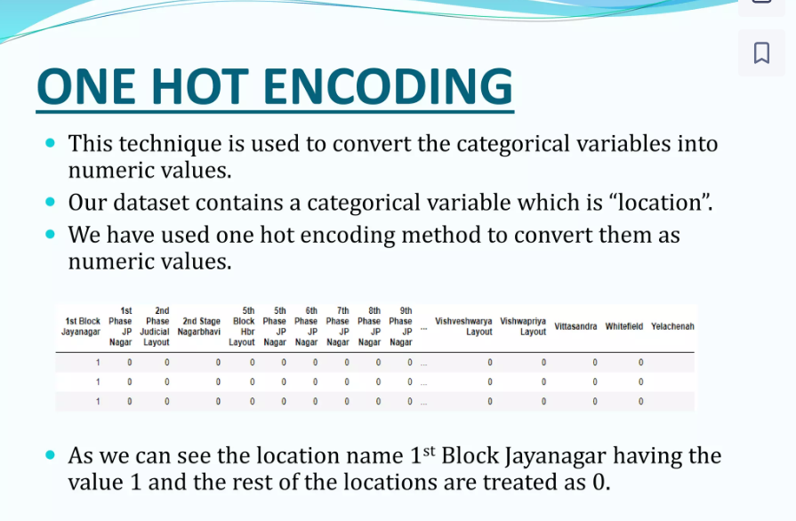
ONE HOT ENCODING
This technique is used to convert the categorical variables into numeric values.
Our dataset contains a categorical variable which is “location”.
We have used one hot encoding method to convert them as numeric values.
As we can see the location name 1st block jayanagar having the value 1 and the rest ofthe location are treated as 0

Slide 13
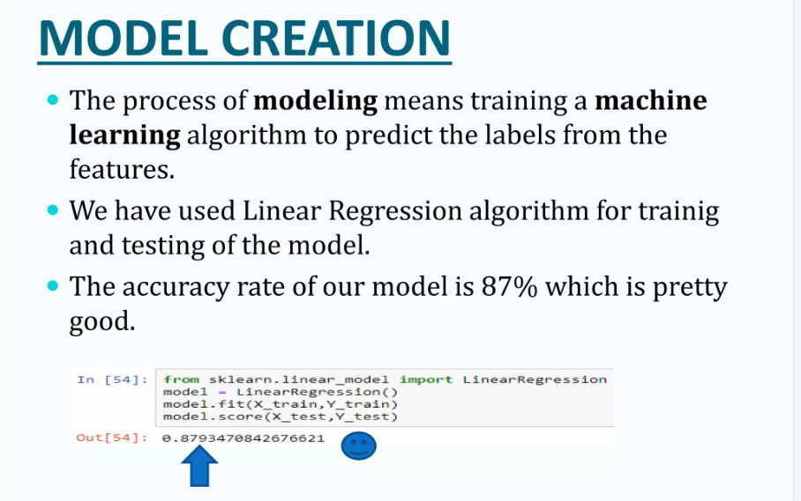
MODEL CREATION
THE PROCESS OF MODELING MEANS TRAINING A MACHINE LEARNING ALGORITHM TO PREDICT THE LABELS FROM THE FEATURES.
WE HAVE USED LINEAR REGRESSION ALGORITHM FOR TRAINIG AND TESTING OF THE MODEL.
THE ACCURACY RATE OF OUR MODEL IS 87% WHICH IS PRETTY GOOD.

Slide 14
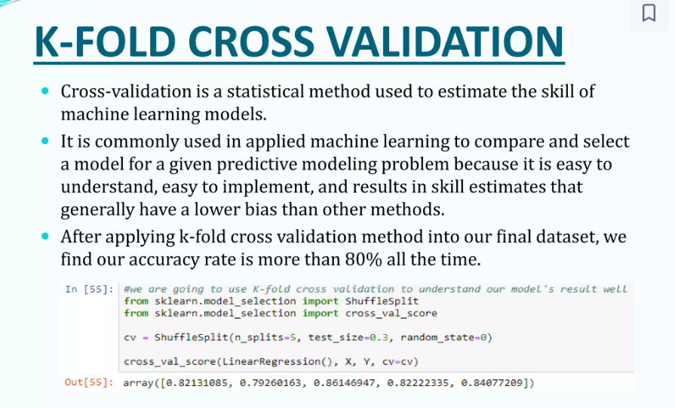
K-FOLD CROSS VALIDATION
CROSS-VALIDATION IS A STATISTICAL METHOD USED TO ESTIMATE THE SKILL OF MACHINE LEARNING MODELS.
IT IS COMMONLY USED IN APPLIED MACHINE LEARNING TO COMPARE AND SELECT A MODEL FOR A GIVEN PREDICTIVE MODELING PROBLEM BECAUSE IT IS EASY TO UNDERSTAND, EASY TO IMPLEMENT, AND RESULTS IN SKILL ESTIMATES THAT GENERALLY HAVE A LOWER BIAS THAN OTHER METHODS.
AFTER APPLYING K-FOLD CROSS VALIDATION METHOD INTO OUR FINAL DATASET, WE FIND OUR ACCURACY RATE IS MORE THAN 80% ALL THE TIME.

Slide 15
GRID SEARCH CROSS VALIDATION
This is a technique which is used to find the best algorithms for the modeling and give the best parameters as well.
We applied grid search cross validation model on our dataset with Linear Regression ,and Decision Tree algorithms.
We find the Linear Regression algorithm is giving the best accuracy score as more the 80%.

Slide 16
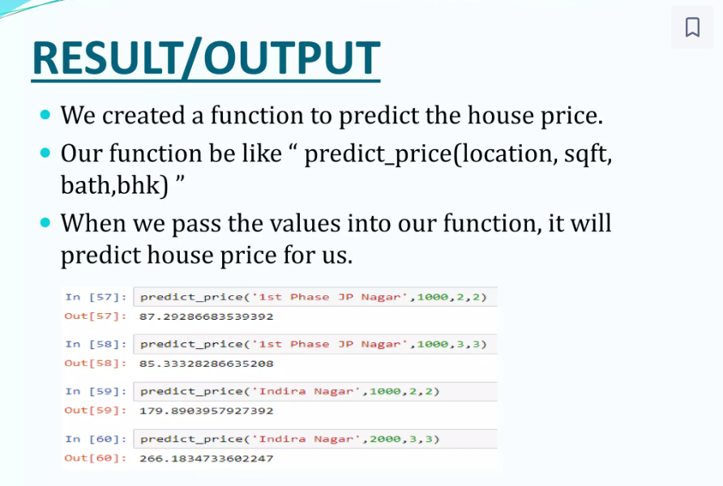
RESULT/OUTPUR
We created a function to predict the house price .
Our function be like “predict_price(location,sqft, bath, bhk)”.
When we pass the value into our function it will predict house price for us .

Slide 17
THANKS SIR!!!

